Slide 1
Data Structures and Algorithms -3 (25CS2103E)
Title of the project: Intelligent Multilingual Spell Checking Suggestion System
Team Members
Name: B.Harini
Rollno. 2520030384
Name: K. Sai Samyuktha
Rollno. 2520030443
Name: B. Devi Charitha
Rollno. 2520030462
Under the Esteemed Guidance of
Mrs. J. Yamini Devi

Slide 2
Contents
Abstract
Introduction
Literature survey
Problem Statement and Objectives
Hardware and Software requirements
Results
Conclusion
Future Scope

Slide 3
Abstract
Abstract
The proposed Intelligent Spell Checker is designed to detect misspelled words and provide suitable correction suggestions automatically. The system uses the Levenshtein Edit Distance algorithm to measure the similarity between a misspelled word and words stored in a dictionary. It calculates the minimum number of insertions, deletions, and substitutions needed to transform one word into another and uses this distance to rank the best possible suggestions.
The system is designed to support multiple languages and Unicode text, making it suitable for diverse types of written content. It also focuses on reducing response time while handling large dictionaries through efficient searching and comparison techniques. The project demonstrates the practical application of dynamic programming in text processing and provides an efficient approach to automated spelling correction.

Slide 4
Introduction
Introduction
Spelling mistakes are common when users type digital content such as messages, documents, assignments, and online posts. These errors can reduce the accuracy and readability of written communication. A spell checker helps users identify incorrect words and provides possible corrections, making the writing process faster and more reliable.
This project develops an Intelligent Spell Checker using Levenshtein Edit Distance, a dynamic programming technique for measuring the difference between two strings. The system compares an incorrectly spelled word with dictionary words and determines the closest matches based on their edit distance. The proposed system also considers multilingual and Unicode text support, along with efficient processing of large dictionaries, to provide accurate suggestions with minimum response time.

Slide 5
Literature Survey
Literature Survey
Spell-checking has been widely explored in Natural Language Processing (NLP) and text-processing applications. Traditional spell-checking systems mainly depend on dictionaries to identify incorrect words and generate possible corrections. However, simple dictionary matching may not effectively determine which word is the closest correction when several similar words are available.
The Levenshtein Edit Distance algorithm has been widely used for approximate string matching and spell correction because it measures the minimum operations required to transform one word into another. Modern spell checkers also use techniques such as phonetic matching, word frequency, context analysis, and language models to improve accuracy. This project focuses on combining edit-distance-based matching with dictionary searching, multilingual support, Unicode compatibility, and efficiency for large dictionaries.

Slide 6
Problem Statement and Objectives
Spelling errors are common in digital text and can affect the accuracy and readability of written communication. Traditional spell-checking systems can detect incorrect words but may struggle to provide accurate suggestions, especially when working with large dictionaries, multiple languages, and Unicode characters. Therefore, there is a need for an efficient intelligent spell checker that can identify misspelled words and recommend the most suitable corrections. The proposed system uses the Levenshtein Edit Distance algorithm to compare misspelled words with dictionary words, calculate their similarity, and rank the best suggestions. The system aims to minimize response time while handling large dictionaries and demonstrates the practical application of dynamic programming in efficient text processing.
The main objective of the project is to provide accurate, fast, and user-friendly spelling suggestions while efficiently handling large dictionaries. The system uses dynamic programming to calculate edit distances efficiently and applies suitable search and ranking techniques to reduce response time. It aims to support multilingual text, improve the accuracy of suggested corrections, and maintain good performance even when the dictionary contains a large number of words. The project also demonstrates the practical application of dynamic programming, string matching, efficient searching, and multilingual text processing in a real-world spell-checking system.

Slide 7
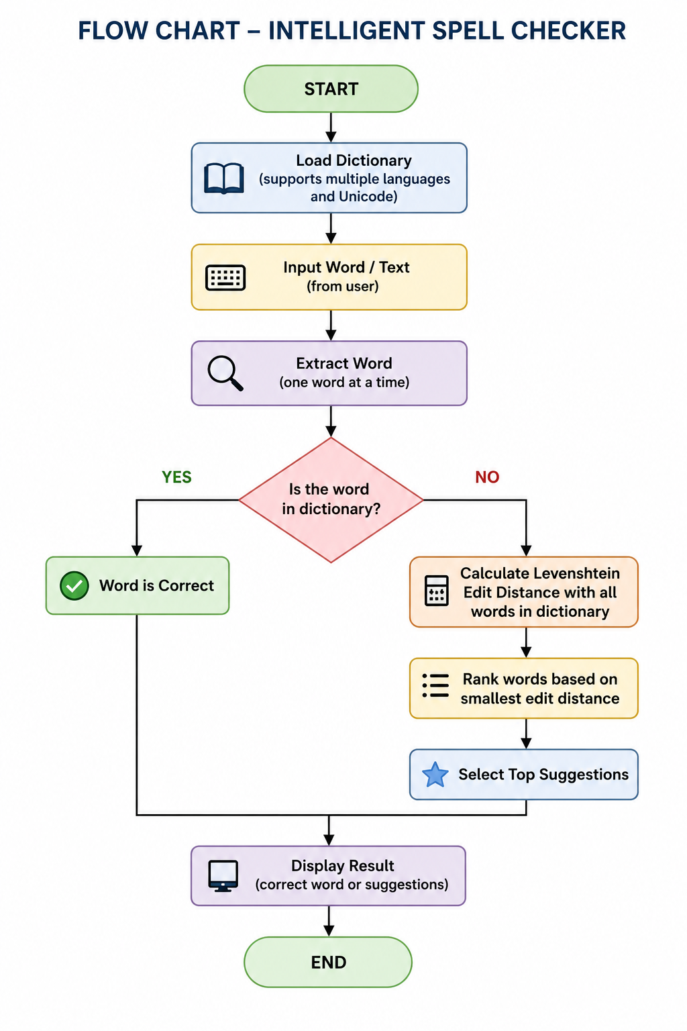
Flow Chart

Slide 8
Results
The Intelligent Multilingual Spell Checking Suggestion System successfully identifies misspelled words and provides suitable correction suggestions using Levenshtein Edit Distance. The system compares the input word with dictionary words, calculates the required insertions, deletions, and substitutions, and ranks the words based on their similarity. It can support multiple languages and Unicode text, making it suitable for different writing systems.
The system provides fast and relevant spelling suggestions while efficiently handling large dictionaries through dynamic programming and efficient searching techniques. The project demonstrates the practical use of dynamic programming, string matching, and multilingual text processing and can be useful in applications such as word processors, search engines, messaging platforms, and educational applications.

Slide 9
Hardware and Software requirements
Hardware Requirements
Processor: Intel Core i3 / equivalent or above
RAM: 4 GB minimum, 8 GB recommended
Storage: At least 500 MB free space
Standard keyboard and mouse
Display: 1024 × 768 resolution or above
Internet connection: Optional, mainly for downloading/updating dictionaries
Software Requirements
Operating System: Windows / Linux / macOS
Programming Language: Python
IDE: VS Code / PyCharm
Libraries: NumPy, Pandas (if required for implementation)
Core Algorithm: Levenshtein Edit Distance using Dynamic Programming
Dictionary: Multilingual Unicode-compatible word database
Text Encoding: UTF-8

Slide 10
Conclusion
The Intelligent Spell Checker provides an efficient solution for detecting misspelled words and generating relevant correction suggestions.
The Levenshtein Edit Distance algorithm accurately measures the similarity between an incorrectly typed word and valid dictionary words.
Dynamic Programming minimizes repeated calculations, making the spell-checking process faster and more efficient.
The system supports Unicode and multilingual text, making it suitable for different languages and writing systems.
Ranked suggestions help users quickly identify and select the most appropriate correction.
The system can reduce spelling errors and improve typing accuracy, readability, and communication quality.
Overall, the project demonstrates the practical application of Dynamic Programming, string matching, efficient searching, and multilingual text processing in a real-world application.

Slide 11
Future Scope
AI-based suggestions: Use Machine Learning/NLP to provide more context-aware corrections.
Auto-correction: Automatically replace highly confident spelling errors.
Grammar checking: Extend the system to identify grammatical mistakes along with spelling errors.
Voice input: Support speech-to-text spell checking.
More languages: Expand the multilingual dictionary to support additional languages and regional scripts.
Personalized dictionary: Allow users to add names, technical terms, and frequently used words.
Cloud/API integration: Make the spell checker available as an API for websites and mobile applications.
Real-time checking: Provide instant suggestions while the user is typing.

Slide 12
Thank you

